Slide 1
Applied Machine Learning Final Project
1
Home credit default risk
INDIANA UNIVERSITY

Slide 2




Group 09:
2
CHANDRA SAGAR BHOGADI
cbhogadi@iu.edu
SRINIVAS VADDI
svaddi@iu.edu
HANISH CHIDIPOTHU
hachid@iu.edu
NIDHI VRAJ SADHUVALA
nsadhuva@iu.edu

Slide 3
CONTENTS:
3
Project Description
EDA(Exploratory Data Analysis)
Overview of Modelling Pipelines Explored
Results and discussion

Slide 4
FOUR P’s:
4
Past:
The HCDR Project involves the prediction of borrowers being the defaulters based on various financial and non-financial data.
Present :
In PHASE 1, we performed EDA on the gathered data and have built a baseline model using logistic regression trying to balance the data by adjusting the number of samples of non-defaulters .
A high accuracy is noticed in the baseline model.
Also, there is a relatively less area under curve. wherein the balancing data improved the area under curve.
We have observed that there was loss of information(samples ) during rebalancing. Therefore, we need to find better ways to improve area under curve while keeping the samples.

Slide 5
5
Planned:
In phase 2, we will introduce Decision Making trees, SVM’s and Random forest.
Feature engineering and feature importance models are performed for improving the input data.
We will improve the AUC by adjusting the hyperparameters.
Problems:
We need a lot more data for better analysis.

Slide 6
Project description:
6
The objective of this project is to predict the repayment abilities of
financially under-served population.
In this project we are considering different kinds of data like, credit history, types of credits, previous applications etc…
The data involves both categorical and numerical data.
By performing EDA we get the accurate machine learning models.
We train and evaluate several models like the linear regression, decision trees, SVM and Random forest.
Different evaluation metrics are used on models along with Accuracy, F1 score, AUC and KS Score.
Finally, we find the best model out of all which gives a satisfactory prediction.

Slide 7
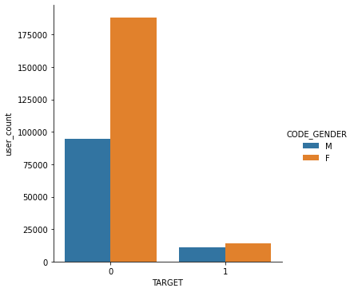
EDA:
7
We perform EDA to find the following
Test Description
Dataset size
Summary statistics
Correlation Analysis
EDA ( Analysis of defaulters and non-defaulters based on gender)

Slide 8
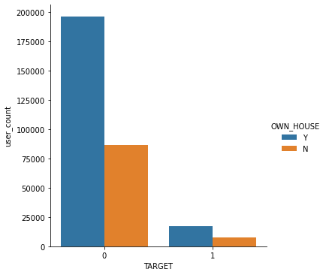
Analysis with respect to Home-owners
8

Slide 9
Modelling pipelines:
9
The main task is to predict if a particular customer is a defaulter or not .
Logistic Regression:
Categorizing the data into train and test data
Data scaling and missing values
Logistic Regression
Accuracy
AUC
Repeating the above steps again and again upon 50,000 and 75000 non- defaulter data

Slide 10
Results:
10
Results for Baseline model
MODEL | TRAIN ACCURACY | TEST ACCURACY | AUC
BASELINE | 91.5 | 91.5 | 0.499
BASELINE FOR 50K DATA | 70.3 | 70.3 | 0.618
BASELINE FOR 75K DATA | 76.4 | 76.1 | 0.553

Slide 11
Discussion of Results:
11
With Re-balancing we observe a higher AUC and less test accuracy.
The baseline models without balancing highest test accuracy, but low AUC.
AUC represents high quality prediction. For better baseline model we need higher AUC.
This baseline doesn’t involve feature engineering and hyper-
parameter tuning.
We observed a high accuracy and less AUC.
Rebalancing improved the AUC.

